Slide 1
C# Advanced
Object Orientation and UML class diagrams
Notes:
Short overview of topic…

Slide 2
Objectives
At the end of this session you'll:
Learn what is UML and its value in describing your design
Understand Interfaces, Inheritance and Polymorphism
Including multiple Inheritance
Understand Aggregation
Learn about the Association Qualifiers

Slide 3
The Unified Modeling Language (UML)

Slide 4
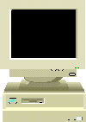
Why Build Models?
Cheaper than building the real thing
To provide a clear abstraction of concepts
To gain understanding, before building
To provide a common vision for diverse groups (users and developers)
To manage, scope and document complexity
Notes:
Why do we build models? Simply because they are cheaper than building the real thing.
Models have been built in many industries in order to ensure the success of the final product. Builders of aeroplanes model the aerodynamic behaviour of planes before committing to construction. Architects draw blueprints of floor layouts, and build scale models of houses, shops and office buildings before the construction crew start implementing the reality in bricks and mortar. UML’s view of a model is based on that of OMT; it is an abstraction of something for the purpose of understanding it before building it.
Models are essential firstly for customer communication and secondly for team understanding. Having a common reference of what is being described helps in most aspects of development, but it is particularly important in system development, where we are often creating things that have no physical comparison. Having a common language to communicate and criticise ideas is probably the most important aspect of a development method. The visualisation of what a system may do, before years of code have been developed, can substantially increase the quality of systems and code.
The human mind can only deal with a small number of concepts at once, then quickly forgets the decisions and ideas developed. Managing, scoping and documenting complexity is a primary goal. Most systems being developed today are too complex to understand directly. UML models reduce complexity by separating out a small number of important things to deal with at a time. This is done using a range of models and development phases, where the attention can be focused on the important issues at that point in the development.

Slide 5
Analysis and Design Workflow
Analysis
The ‘what’
Defining the problem space
A conceptual model to facilitate understanding
Unaffected by software considerations
Unaffected by performance considerations
Design
The ‘how’
Defining the solution space
A specification model to facilitate implementation
Improving the software
Improving the performance
Notes:
The Unified Process might not have distinct analysis and design phases or workflows, it does distinguish between analysis and design activities. These may well be done in close proximity. Prototyping is a design activity, as is deciding on architecture, yet these are done while requirements are being modelled.
Analysis is about understanding and making that understanding clear. The analysis process is about developing and deepening that understanding and verifying that it is consistent with the domain experts’ views. Although the analysis should not propose a solution or design, a good analysis model usually looks like a reasonable solution. The most important differential between analysis and design is that the design of a solution should be constrained by the understanding gained by analysis, but not by the representation of analysis.
Design is about creating a specification that can be implemented, but that is conceptually consistent with the analysis. This is usually a software specification of classes, associations, attributes, operations, methods, etc., but can equally be a hardware specification of types of components, connections, memory, interfaces or functions, or a wetware specification of jobs, relationships, documents, work flow or procedures.
Whereas the analysis should stress clarity, design must trade this off against performance, maintenance, reuse, etc.
As the analysis and design notations are identical, care must be taken by both writers and readers to ensure that the models are interpreted as intended.

Slide 6

What is UML?
A graphical and textual notation for concepts
Rich and expressive, but can be used simply
Text allowed/encouraged when graphics prove difficult
A meta-model of the notation
Defines the syntax and semantics of the notation
Useful for tool builders and code generators
UML is independent of process and lifecycle
The unified process was designed for UML
It specifies a lifecycle and workflows
Notes:
The UML is not a method, it is only a language. However UML has the advantages of being a better, more complete, less ambiguous notation than its predecessors, and can be customised more easily while retaining widespread consulting, training and CASE tool support.
The Unified Process was created by the UML authors to guide development organisations in ways of applying UML. It specifies a lifecycle, workflows and much more besides.

Slide 7
UML History
UML is the industry standard OO notation – from 1995
Principal authors of OMT (Rumbaugh) and Booch, and Objectory (Ivar Jacobson)
OMT
BOOCH
OOSE
Objectory
Fusion
UML
⊗
Ο
Notes:
OO modelling languages (and books) multiplied in the early 90’s e.g.Wirfs-Brock, Coad/Yourdon, Booch, OMT, Odell/Martin, Jacobson, Shlear Mellor. The diversity bread innovation but also some confusion. By 1994 there were many similar concepts, incompatible notation and few support tools.
Late 94. Rumbaugh joins Booch at Rational
Late 95. Rumbaugh and Booch produce "Unified Method" 0.8
Jacobson joins Rational - "The Three Amigos"
1996: OMG Issues RFP, Amigos release UML 0.9 and 0.91
UML Partners to work on UML 1.0
Jan 1997: Submission to the OMG.
Nov 1997: OMG adopts UML 1.1
The UML notation has reused the best bits of the above methods, while drawing on the experience of the main authors of OMT, Booch and OOSE, and has evolved through early drafts, using feedback from the industry at large.

Slide 8
Requirements
Functional requirements define what a system must do
Non-functional requirements capture other goals and constraints on how the systems is built
Performance and capacity
Availability and fault tolerance
Scaleability
Time to market
Cost of ownership and development
Quality
Portability
Tools and platforms to be used
Reuse of existing resources
Produce reusable components
Non-functional requirements

Slide 9
Requirements Analysis
The Use Case model provides a high-level view of system functionality
Defines the range of a system; what’s inside, what’s outside, what it does and what it doesn’t do
Actors are external
Use Cases are internal
Win Hand
Player
Notes:
An actor is any person, organisation, system or device that is outside the system boundary, but that interacts, directly or indirectly, with the system. For example, a guest interacts with an hotel system.
A Use Case is a high-level view of an actor’s use of the system.
It is vitally important to have a well-specified system boundary.

Slide 10
Delving into Problem Space - Processes
Business Process Modelling with Activity Diagrams helps us to understand:
What we are doing now
Where the problem lies
Which business processes need attention
Sell Items
Sales
[Order Rejected]
<<ebp>>
Receive Order
<<ebp>>
Close Order
[Order
Accepted]
Warehouse
<<bpg>>
Ship Order
<<bpg>>
Fill Order
Finance
<<bpg>>
Get Order Payment
Notes:
All Agile frameworks have the high-level requirements expressed as business processes. These may be Elementary Business Processes(EBP) (DSDM), Use Cases or User Stories (XP and Scrum).
All these requirements are effectively defined the same way – 1 person, 1 session, 1 ‘sitting’.
If using UML in your Agile framework, then you will use Use Cases that are a 1-1 mapping from EBP.
Necessary EBP are obtained from Business Process Modelling with Activity Diagrams

Slide 11
Static Modelling
The class diagram provides more detail
A static view of the internals of the problem
The class diagram provides the framework
Elaborated in business entities, definitions and relationships
DrawPile
CollectionofCards
pickup()
Card
visibility
Deck
initialise()
suit
location
rank
*
shuffle()
*
initialise()
deal(hands)
display(location, faceUp)
delete(card)
initialise()
DiscardPile
discard()
insert(card)
getBottomOfPile()
pickup()
getTopOfPile()
Hand
initialise()
initialSize
Partial static model for card playing system
sort()
initialise()
Notes:
The class diagram is the repository of the majority of analysis and design information. It initially contains a whole system perspective, gathered from all the Use Cases (each of which has provided a more limited perspective). All new discoveries throughout the rest of analysis will be added to the class diagram.
The classes will all be business entities that are recognisable to domain experts and users.
The model above is showing that cards are part of a collection of cards. Collections of cards can be found in four different kinds; deck, hand, discard pile and draw pile.
The deck, hand, discard pile and draw pile do everything that the collection of cards does and more. Deck, hand, discard pile and draw pile all initialise in their own way.

Slide 12
Dynamic Modelling - interaction
Scenarios and sequence diagrams provide more detail
A dynamic view of the internals of the problem
They provide feedback to the class diagram
Identifies relationships, operations and new classes
DocHoliday:Player
<<actor>>
:Game
:Deck
:Hand
:DrawPile
1. System shuffles and deals cards.
2. Doc Holiday pickups from the drawpile …. etc
shuffle()
deal(hands)
Initialise ()
sort()
Partial scenario and sequence diagram for card playing system
pickup ()
Notes:
The use cases and basic class diagrams are not in themselves enough to understand the problem domain, specify a design or understand an existing system. The use case diagram, while describing the functionality of a system, does so at such a high level, that detailed understanding of the functionality is simply not present. Similarly, the basic class diagram really supplies us with a list of domain terms, but neither adequately describes what they mean, nor how they interact. We will look at building this understanding, i.e. it provides a more detailed functional view of the system, a better description of our domain terms, and a model of how these domain items interact dynamically.
Scenarios are examples of an actor exercising a use case.
Sequence diagrams show the interactions between the actor and the objects within the system for a single scenario. These interactions are in the form of messages (events) between objects.

Slide 13

UML Association
Association example: Customer has a reference to Account
class Customer
{
Account account;
public Customer()
{
account = new Account();
}
}

Slide 14

UML Dependency
Dependency (looser association) example 1
class Bank
{
public void Register(Account acc)
{
acc.Open();
}
}
Passed in as a parameter and used only in the method

Slide 15
UML Dependency another example
class Bank
{
public void CreateAccount(int id)
{
Account account = new Account(id);
accounts.Add(account);
}
}
Created and used within the method

Slide 16
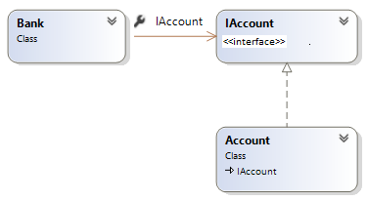
UML Dependency – reducing hard coupling
class Bank
{
public void Register(IAccount acc)
{
acc.Open();
}
}
A kind of account is passed in as a parameter and used only within the method

Slide 17
Interfaces, Inheritance And Polymorphism

Slide 18

Interfaces – a reminder
Suppose we have a car, a capital asset and an employee, all of which are taxable :-
The Inland Revenue
Genevieve : Car
CalcTax( taxableItem )
If taxableItem = Car Then
calcTax = call getTaxDue operation on taxableItem object
End if
If taxableItem = CapitalAsset Then
calcTax = call findGainsTax operation
on taxableItem object
End if
If taxableItem = Employee Then
calcTax = call returnYearTaxAmount
on taxableItem object
End if
CalcTax = call GetTax on taxableItem object
GetTaxDue()
my : DepositAccount
Wouldn’t it be just great to help the tax office achieve this level of simplicity ?
FindGainsTax()
Me : Employee
returnYearTaxAmount()
X

Slide 19
Interfaces - 2
Step 1 – Adapt what you got
Either rename the differently named procedures, or put in another procedure that then just calls the original.
Genevieve : Car
My : DepositAccount
Me : Employee
GetTax()
GetTax()
{
return FindGainsTax();
}
FindGainsTax()
GetTax()
Notes:
In order to keep the logic of the calling code simple each calls needs to have an operation with the same signature. It may be possible to simply rename some of the operations, alternatively an additional operations can be added that wraps the original.

Slide 20
Interfaces – The Promise
So far so good. But now, how does the Tax Office know that Car, Deposit Account and Employee all now have the same named procedure : GetTax () :-
The Inland Revenue
CalcTax()
{
return .GetTax()
}
Taxable
Taxable
Taxable
GetTax
GetTax
taxableItem.
SetTaxCode
GetTax
SetTaxCode
SetTaxCode
Genevieve:Car
GetTax()
me : Employee
GetTax()
my : DepositAccount
GetTax()
x
Notes:
When the logic is run the appropriate implementation will be invoked using dynamic binding. (i.e. at runtime the system does a behind the scenes lookup. It asks what kind of object is this? And then executes the appropriate method) e.g. C++ uses the v table to look up the appropriate function pointer.
It is the dynamic binding that supports the removal of ifs and case statements. Each operation has the same name, inputs and outputs. E.g. the operation name for all of the classes above is getTax with no inputs parameters and a Money return.

Slide 21

Ignorance & Apathy
Now the Inland Revenue doesn’t know and doesn’t care what sort of object it is – provided its taxable :-
The Inland Revenue
CalcTax()
{
return GetTax()
}
Taxable
Taxable
Taxable
taxableItem.
GetTax
GetTax
SetTaxCode
GetTax
SetTaxCode
SetTaxCode
All you’ve got above the waterline is the Named Flagpole.
From this name (“Taxable”), the supported operations are known and “magically” redirected by the object itself
The "sea" of all objects
x
Notes:
The calling code invokes getTax on each object. The TaxOffice object does not care that some of these objects are deposit accounts, some are employees and some are cars. It only cares that they are taxable.
By separating the interface from the implementation the taxoffice is only dependent on the interface and not the an entire class that includes both interface and implementation. So only if the interface changes (e.g. getTax requires a parameter) does this impact the tax office. If the bank account implements a new algorithm for calculating tax this will not impact the tax office as long as the operations specification stays the same.
Note that the operation specification consist of the name of the operations, the parameters(their order) and the returns.

Slide 22

In Elevation View
AddInterest()
AddInterest()
Common Stuff
AddInterest()
Common Stuff
AddInterest()
Cheque Account
Deposit Account
Interface is commonality of signature.
What if you have some commonality of substance as well ?
eg in this example there are some “Accounty” bits which really are common
x
Notes:
.
Note that the operation specification consist of the name of the operations, the parameters. Some classes also share common logic i.e. common methods. Cheque accounts and deposit accounts may both have some common functionality to withdraw and deposit cash. Rather than duplicating this twice in both classes. It would make more sense to define this logic once.

Slide 23
Inheritance
AddInterest()
AddInterest()
AddInterest()
AddInterest()
Cheque Account
Deposit Account
Interface is commonality of signature
Inheritance is commonality of signature and substance
= inheritance of interface
= inheritance of implementation

Slide 24
Inheritance
AddInterest()
AddInterest()
AddInterest()
Cheque Account
Deposit Account
E.G Cheque Account chooses to use the default "Account" AddInterest() and by declaring nothing automaticallygets this "base class" version.
This is programming by difference.
Notes:
One strategy that can be used to share functionality is using inheritance. The "is a kind of" rule and the substitutability rule should still apply.(see inheritance chapter)
Inheritance allowance the sharing not only of operations but also of attributes , methods and associations. An interface is never instantiated. A parent class can be concrete or abstract. If concrete it can be instantiated.
Inheriting from abstract classes has the advantage of greater extendibility than inheriting from concrete classes. Realising interfaces is even more flexible still than inheriting from an abstract class.
The only dependency between the realisation and the interface is the operations. The Realisation does not have any dependency on the common implementations only the common operations. This will improve maintainability of the system as we are reducing dependencies. If we make a change in the future it is less likely to impact other parts of the system.

Slide 25
They are both "is a" or "is a kind of"
Inheritance should only be used when the "is a kind of" rule applies.
A subclass "is a kind of" superclass
A CheckAccount "is a kind of" Account
A DepositAccount "is a kind of" Account
Account
Account
accountNumber
accountNumber
Inheritance notation in UML
Withdraw()
Withdraw()
Deposit()
Deposit()
AddInterest()
AddInterest()
Close()
Close()
CheckAccount
DepositAccount
CheckAccount
DepositAccount
Withdraw()
Withdraw()
Withdraw()
Withdraw()
Deposit()
Deposit()
Deposit()
Deposit()
AddInterest()
AddInterest()
AddInterest()
AddInterest()
Close()
Close()
Close()
Close()
Notes:
Unfortunately, programming languages cannot enforce these semantic rules, and it is easy to find examples in commercial software that break these rules. Sticking rigidly to these rules will make it easier for your classes to be understood.
An additional rule is that a subclass should never omit any of its superclasses' operations or attributes. If even one operation or attribute does not make sense on a subclass, the inheritance hierarchy is wrong. Not providing a method for an operation, or overriding a superclass method to do nothing indicates that the subclass behaves differently to the superclass.
The above 2 notations have identical meaning.

Slide 26
Interface Notation in UML
These 2 notations are both equally valid UML
<<interface>>
Taxable
GetTax()
Employee
Taxable
dotted
The correct term for this is "to realize" an interface
GetTax()
Employee
GetTax()
Would you say "an Employee is a kind of taxable (item) ?
Or does it sound better to say "an Employee supports all Taxable Operations?
Notes:
Interfaces can be replaced graphically by a named circle. The definition of the interface is defined elsewhere, either graphically or in the repository of a CASE Tool.

Slide 27
And what’s Polymorphism ?
Is the ability to exist in different forms
Enables us to treat different objects the same way
IVehicle
Move
Refuel
IVehicle
Move
Refuel
IVehicle
Move
Refuel
Notes:
The object offering the interface must give a response that does not surprise the client.
If the response surprises the client, then you’ve lost the whole advantage of polymorphism as the client now has to be aware of the detail.

Slide 28
Using Polymorphism
Each object offers the interface "IVehicle"
IVehicle
Move
the collection of vehicles
Refuel
GetRoadTax
Car
Truck
Motor
Cycle
Car
For each Vehicle in collection of Vehicles send message GetRoadTax()
Truck
Motor
Cycle
Motor
Cycle
Car
Car
Truck
Motor
Cycle
Truck
Motor
Cycle
Truck
Car
Notes:
In our example, the license authority application knows about many Trucks, Cars and MotorCycles. Objects of different types could be placed in a single collection. The collection of different types of object can be viewed as a collection of Vehicles.
This is a very powerful view of the collection. Each object is selected, its actual type unknown and it is treated as an IVehicle and asked to GetRoadTax.
The message GetRoadTax is sent to each object (Vehicle) in turn, and each object fulfils the IVehicle contractual interface in its own way.

Slide 29
Abstract Base Class
You could view an interface as a degenerate version of an Abstract Base Class
Mammal
Account
accountNumber
Withdraw()
generalisation
You can’t create
a mammal, or
An Account.
They are
abstract classes
Deposit()
AddInterest()
Close()
specialisation
Dog
CheckAccount
DepositAccount
Withdraw()
Withdraw()
Deposit()
Deposit()
AddInterest()
AddInterest()
Close()
Close()
x
Notes:
There are many concepts that we use in everyday life that certainly never manifest themselves as objects – they are just concepts.

Slide 30
What’s the Difference ?
Account
accountNumber
CheckAccount
Withdraw()
Deposit()
Withdraw
AddInterest()
Close()
Deposit
AddInterest
Close
CheckAccount
DepositAccount
Withdraw()
Withdraw()
Deposit()
Deposit()
AddInterest()
AddInterest()
Close()
Close()
Inheritance Of Interface
And
Inheritance Of Implementation
Inheritance Of Interface
Notes:
To the client there is absolutely no difference. The client has no awareness of how the CheckAccount object may be built.
If the CheckAccount object happens to be built using inheritance, then the author of the CheckAccount just programs by difference.
If the CheckAccount is built using just interface, then the author has to put in the code.

Slide 31
Aggregation
The arrow and the names of the propagated operations can only be used with aggregation (and composition, which we'll discuss later)
In the above example, a customer can have zero to many accounts
You can use numbers to restrict creating of BankAccounts
Customer
*
BankAccount
ConvertCurrency(newCurrency)
Customer
1..3
BankAccount
ConvertCurrency(newCurrency)

Slide 32
Composition – Delegation of work to other objects
The arrow and the names of the propagated operations can only be used with aggregation (and composition, which we'll discuss later)
Customer
*
BankAccount
ConvertCurrency(newCurrency)
1
ConvertCurrency
1..*
Transaction
ConvertCurrency(Currency)
Sending message ConvertCurrency to a BankAccount object, causes the message to be propagated to the transactions of the BankAccount

Slide 33
Aggregation – look for delegation
Its an Asymmetric relationship
BankAccount
*
Transaction
balance: Money = 0
create, archive
amount: Money
Dog
0,1
Tail
balance: Money = 0
create, wag, droop
amount: Money
Car
*
Engine
balance: Money = 0
start, stop, service
amount: Money
Boss
*
Employee
balance: Money = 0
just do it
amount: Money
Notes:
The diamond is shown next to the class designated as the whole. The other object is the part. There is no need for an association name or role names; the aggregation defines that the whole 'is made up of', or 'contains', or 'has' the parts, and the parts 'are part of', 'are contained by' or 'belong to' the whole.
In an example of a Car to Chassis relationship, there is aggregation, because:
There is a whole-part relationship; the Car is a whole, the chassis part of it.
Chassis’ don't normally exist independently (except in a manufacturing situation).
If the Car is crushed in a junk yard, the Chassis would be crushed too.
To check a chassis number, you would first identify the Car.
If you drive the Car to Glasgow, the Chassis would go as well.
In an example of a Car to Driver relationship, there is not aggregation, because:
There is no whole-part relationship.
Each exists without the other.
Cars and Drivers are created and destroyed independently.
Access to Cars is independent of access to drivers.
Although the Car may be driven to Glasgow, and the Driver would
probably go with it, the Driver could also take the train to Edinburgh.

Slide 34
Aggregation In-Situ Exercise
Objective
To practice differentiating aggregation from association
Task:
As a group , decide for each of the following whether each aggregation or association would be most appropriate
A track on a CD
A mobile phone has a battery
A portfolio contains assets
A car parked in a car park
An organisation has many departments
A person driving a car
A guitar has strings

Slide 35
Advanced Design Concepts

Slide 36
Bad Design
What do we mean by a bad design
Rigid:
Hard to make changes.
To change the length of an ID from 4 characters to 5 takes months!
Fragile:
Changes that are made cause undesirable consequences
So badly put together than even a small change may have bad/catastrophic consequences
Immobile:
Hard to reuse in another application
Application/modules written in monolithic module, specific to the current task that it may not be used/shared by any other project
Application written for Windows and needs a complete re-write if it becomes a web application.

Slide 37
Solid principals to rescue
Follow these principals and you'll have a good chance of delivering good design and code
Single Responsibility
Open-Close
Liskov Substitution
Interface Segregation
Dependency Inversion

Slide 38
Single Responsibility Principle
Each class should only have one responsibility
Each class should have only one reason to change its behavior
No 'Kitchen Sink' classes.
A class called QA which has all the methods needed to run QA!
This principal promotes decoupling.
If you want to change an aspect, you'll have a lot less code changes
Code is reusable; by combining responsibilities other classes won’t be able to use a single responsibility from the class.
If you've a large class the chances are it's multiple responsibilities
Just break it up into smaller classes which in turn makes the class easier to test.

Slide 39
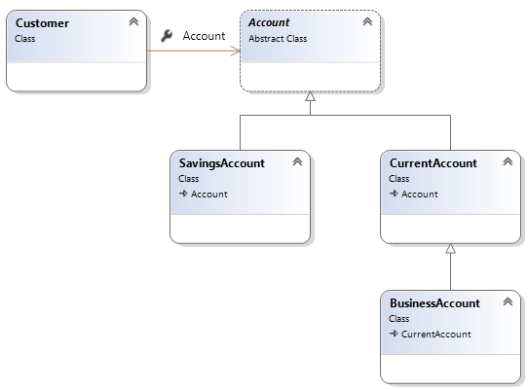
Open Closed Principle
Open for extension, closed for modification.
Software entities should be extendable, but not modifiable.
Changes in requirements are performed using extension rather than modifying existing classes
Apply abstraction and polymorphism.

Slide 40
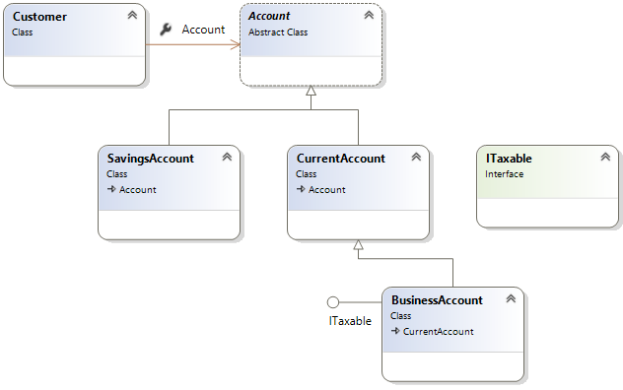
Open Close principal example

Slide 41
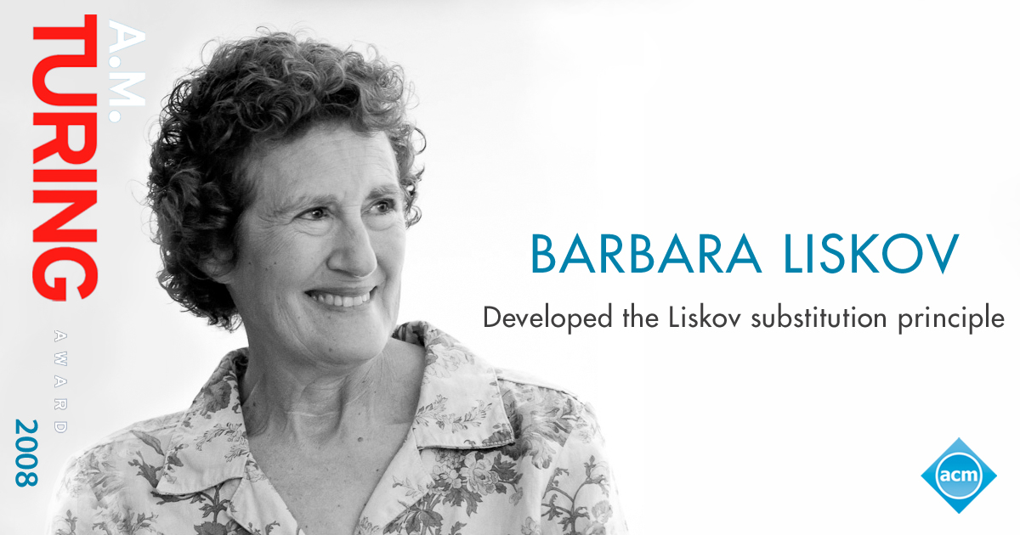
Liskov Substitution
Sub-classes behaviour should be the same as the super-classes
Should fulfil all behaviours of the base class correctly.
The behaviour of a derived class should have a stronger post-condition and a weaker precondition than the base class.
(you'll see this in the next few slides)
Liskov substitution principal prevents classes having undesirable behaviours.

Slide 42
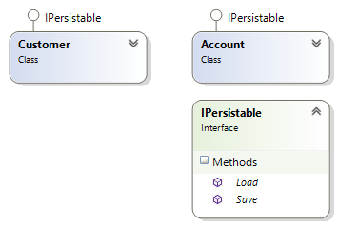
A simple example of the Liskov Principle
interface IPersistable {
void Save();
void Load();
}
class Customer : IPersistable {
public int ID { get; set; }
public string Name { get; set; }
public void Load() {
// Read a data store and set // the ID and Name properties
}
public virtual void Save() {
// Save instance properties to a permanent data store
}
}

Slide 43
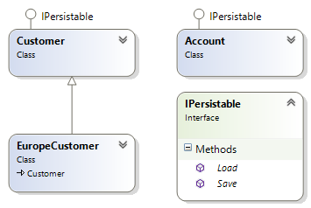
Add a new class called EuropeCustomer
class EuropeCustomer : Customer
{
public void Load()
{
// Load object data
}
public override void Save()
{
if (DateTime.Now.Hour < 12)
{
// Save instance properties
}
}
}

Slide 44
What is the effect of the new Customer class
What happens if one of the objects in the List is an EuCustomer?
class Manager
{
public void SaveObjects(List<IPersistable> objects)
{
foreach (var item in objects)
{
item.Save();
}
}
public void LoadObjects(List<IPersistable> objects)
{
foreach (var item in objects)
{
item.Load();
}
}
}

Slide 45
Dependency Inversion Principle (DIP)
High-Level modules should not depend on low-level modules – both should depend on abstractions
Abstractions should not depend on details. Details should depend on abstractions.
Instead of working with hard-wired / highly coupled classes you should always attempt to use interfaces
Let's have a look at a simple example
Notes:
You can think of DIP as being an outgoing interface of the ‘dependent’ class rather than an incoming interface of the dependee class. You have to try and establish the abstraction that underlies the application – that set of concepts and behaviours that doesn’t vary when the details are changed.
This is such an important principle that a mechanism has been subsumed into the .NET framework – delegates do exactly this.
It is also sometime known as “The Hollywood Principle” – don’t call us, we’ll call you.

Slide 46
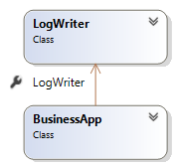
DI example – Bad design
The following code logs message in a console
But the higher level class (BusinessApp) has a dependency on a concrete class (LogWriter)
This violates the DI principle
What if you want to send email instead?
public class LogWriter {
public void Write(string message) {
File.WriteAllText("Log.txt", message);
}
}
public class BusinessApp {
LogWriter logger = new LogWriter();
public void Log(string message) {
logger.Write(message);
}
}

Slide 47
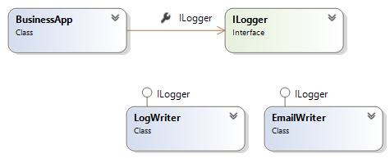
DI Example – Better design
The BusinessApp now depends on abstractions (ILogger interface)
BusinessApp has now got the freedom to Log messages using emails

Slide 48
The C# Code for our DI first attempt
public interface Ilogger {
void Write(string message);
}
public class LogWriter : Ilogger {
public void Write(string message) {
File.WriteAllText("log.txt", message);
}
}
public class EmailWriter : Ilogger {
public void Write(string message) {
Outlook.Send("admin@qa.com", message);
}
}
public class BusinessApp{
ILogger logger;
public void Log(string message) {
if (logger == null)
logger = new LogWriter();
logger.Write(message);
}
}
Could improve!

Slide 49
Dependency Injection (!= Dependency Inversion)
Is for injecting the concrete implementation into a class that uses an abstraction (like an interface)
You can inject dependencies in a Method/Constructor/Property
public class BusinessApp {
ILogger logger;
public BusinessApp(ILogger messageLogger) {
logger = messageLogger;
}
public void Log(string message, ILogger messageLogger) {
logger.Write(message);
}
}
static void Main()
{
BusinessApp app = new BusinessApp(new EmailWriter());
// other code
}

Slide 50
Interface Segregation
Interfaces should be specific to a client. Many specific interfaces are better than one general purpose interface.
By using specific interfaces, it will present a clear understanding on what behaviours the client should use.
Additionally segregating interfaces increases usability of interfaces as interface implementers should only use behaviours that are relevant.
Let's have a look at an example…

Slide 51
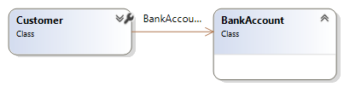
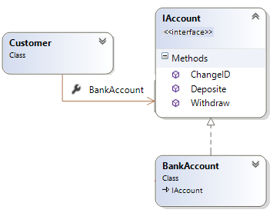
Customer association to a bank account
First attempt: What could be the problem with this design?
Second attempt: Is this solution better? Why?
Yes! Customer can extend another class
But what could be a problem with this solution?

Slide 52
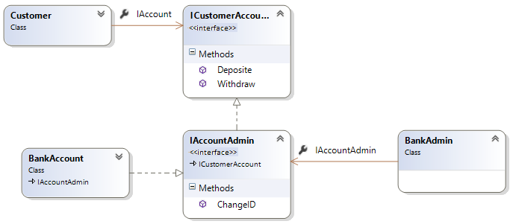
Third attempt – Create many interfaces
We should not allow customers to change their account ID!
How would you solve this problem?
The answer is to give customers their own account interface
The bank should have the ability to change IDs and also have the same capabilities as a customer

Slide 53
Summary
At the end of this session you…
Learn what is UML and its value in describing your design
Explored and understand the reason for Interfaces, Inheritance and Polymorphism and how to use them.
Including multiple Inheritance
Have understood the use of Aggregation
Learned about the Association Qualifiers
Learned to described Encapsulation (Visibility)
Were able to demonstrate the use of Derived Attributes and Class Attributes

Slide 54
Lab 1/2
Please review the questions in 8-OO and UML.docx file
Answers are included in the document
Please do not look at the answers first!

Slide 55
Patterns
What is a pattern?
is a general reusable solution to a commonly occurring problem within a given context
Provides a template for solving problems
Creates a communication shortcut with other designers and speed up the development process

Slide 56
A few common patterns
Singleton
This pattern is used to create a single instance of a class in your application
For example, there should only be one Game object in a Game application, One Bank object in an application about Bank
Factory
Creates other objects
Often used with a Singleton patterns because one instance of factory will be enough in most applications
Abstract factory
Like Factory, but it can create families of related objects
Composite
Treats individual objects and compositions of objects uniformly
Decorator
Attach additional responsibilities to an object dynamically keeping the same interface. Provides a flexible alternative to subclassing for extending functionality.
There are many more

Slide 57
Lab 2/2
In groups of 3/4 , investigate a pattern
Use sites like http://www.oodesign.com/
Decide as a class, pick different patterns
Write your research and UML diagrams on flipcharts
You can also take a picture of your design and even better produce slides
Present your conclusions to the class
You may present as a group together

